Slide 1
Operational Amplifier: Comparator Math

Slide 2
Outline
Op-Amp: Comparator (Recap)
Open Loop Configuration: Example 1
Open Loop Configuration: Example 2
Open Loop Configuration: Example 3

Slide 3
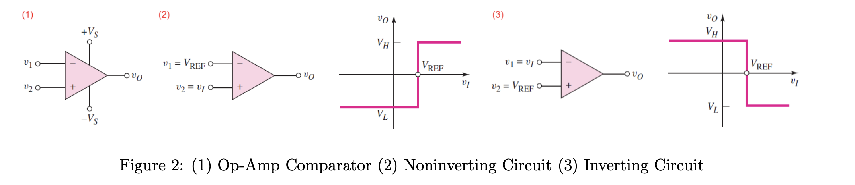


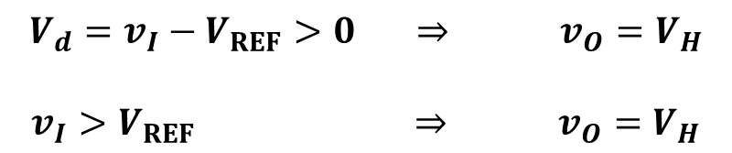
Op-Amp: Comparator (Recap)
Level Crossing Detector / Comparator
NON-INVERTING COMPARATOR

Slide 4


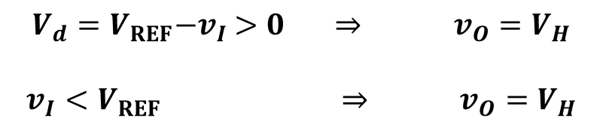
Op-Amp: Comparator (Recap)
Level Crossing Detector / Comparator
INVERTING COMPARATOR

Slide 5
Op-Amp: Comparator (Recap)
Level Crossing Detector / Comparator

Slide 6
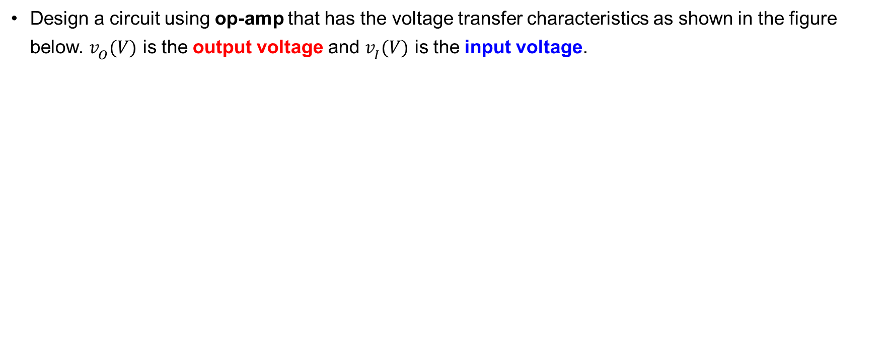
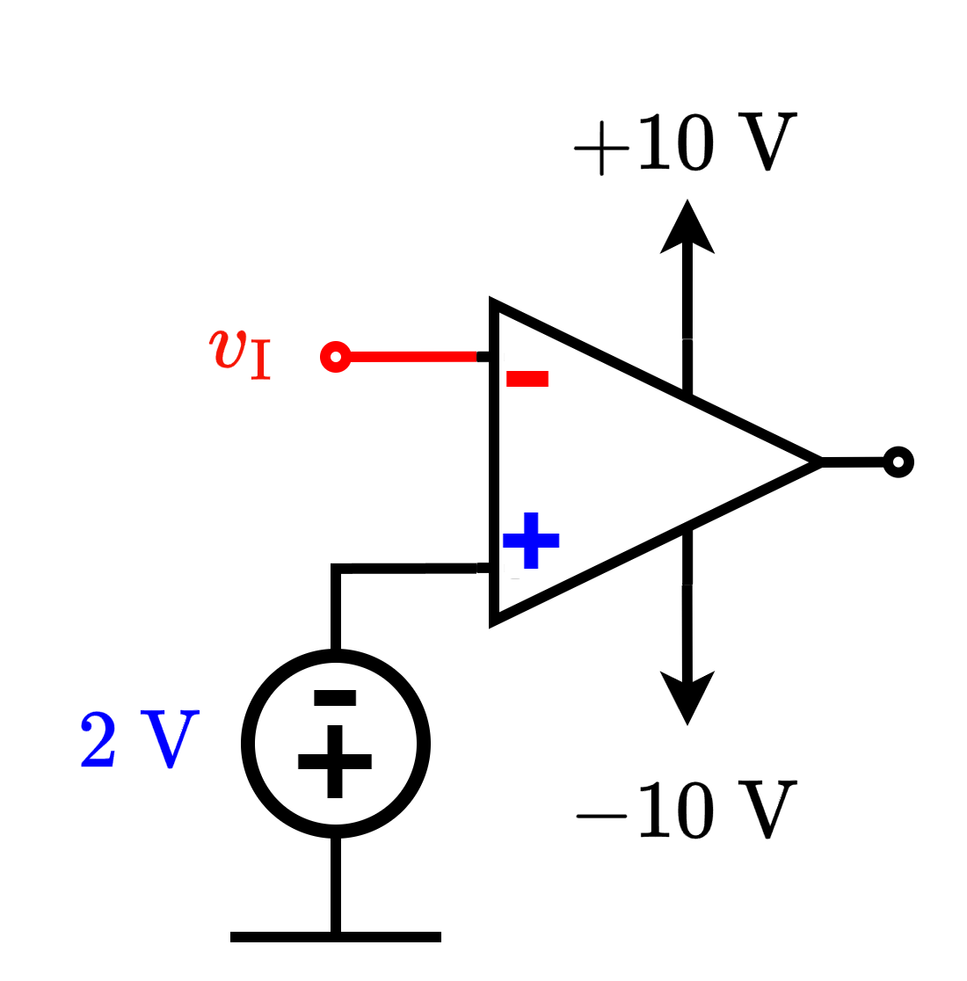
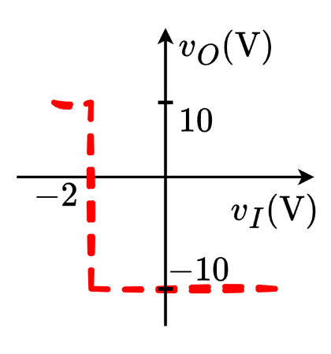
Open Loop Configuration: Example 1
Solution:

Slide 7
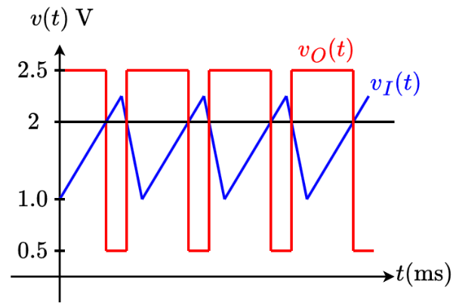
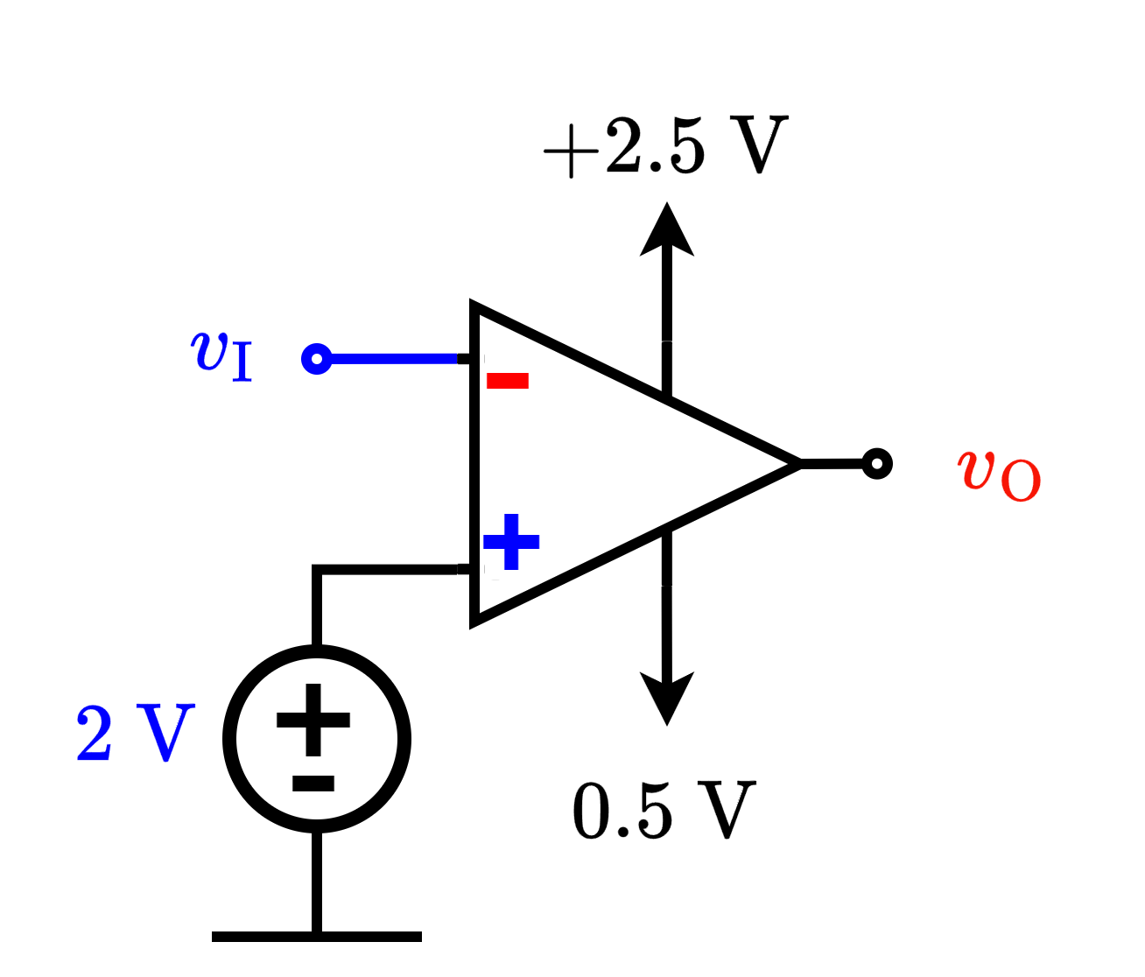
Open Loop Configuration: Example 2
Solution:
INVERTING CONFIGURATION

Slide 8

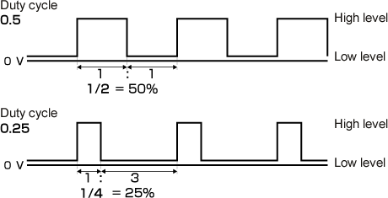
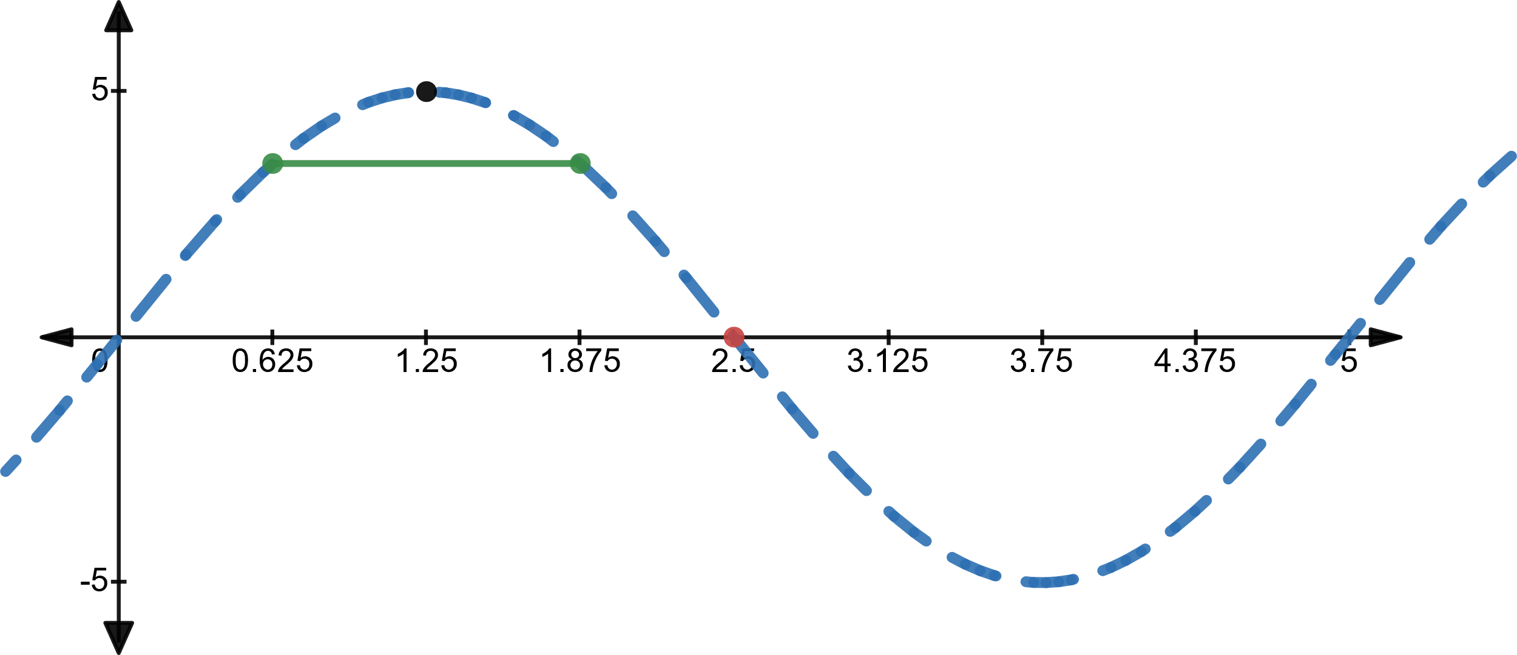







Open Loop Configuration: Example 3

Slide 9
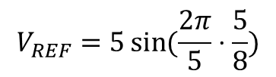
Open Loop Configuration: Example 3

Slide 10
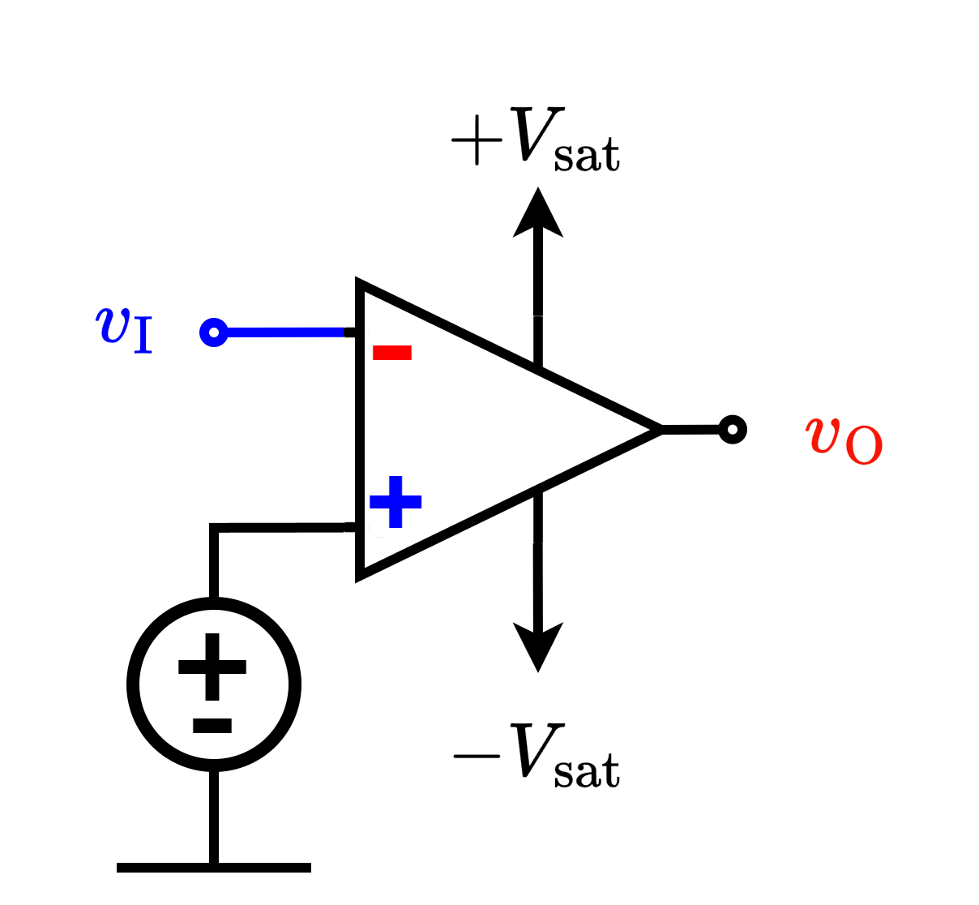
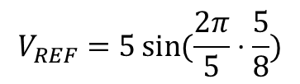
Open Loop Configuration: Example 3

Slide 11
Thank you

